Slide 1
Microblaze Implementation of a Multicolored LED Control System
Justin Bui

Slide 2
Agenda
Project introduction
Inspiration
HDL Development
C++ Development
Potential Future Implementations

Slide 3
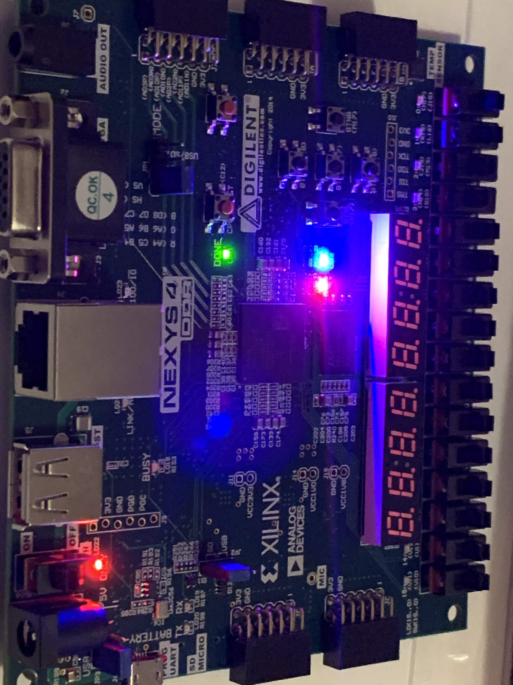
Project Introduction
Control System for the Nexys 4 DDR RGB LEDs
Features:
Each LED is controlled Independently
100MHz Update (Rapid Response)
Easy To Use Set and Clear Commands

Slide 4
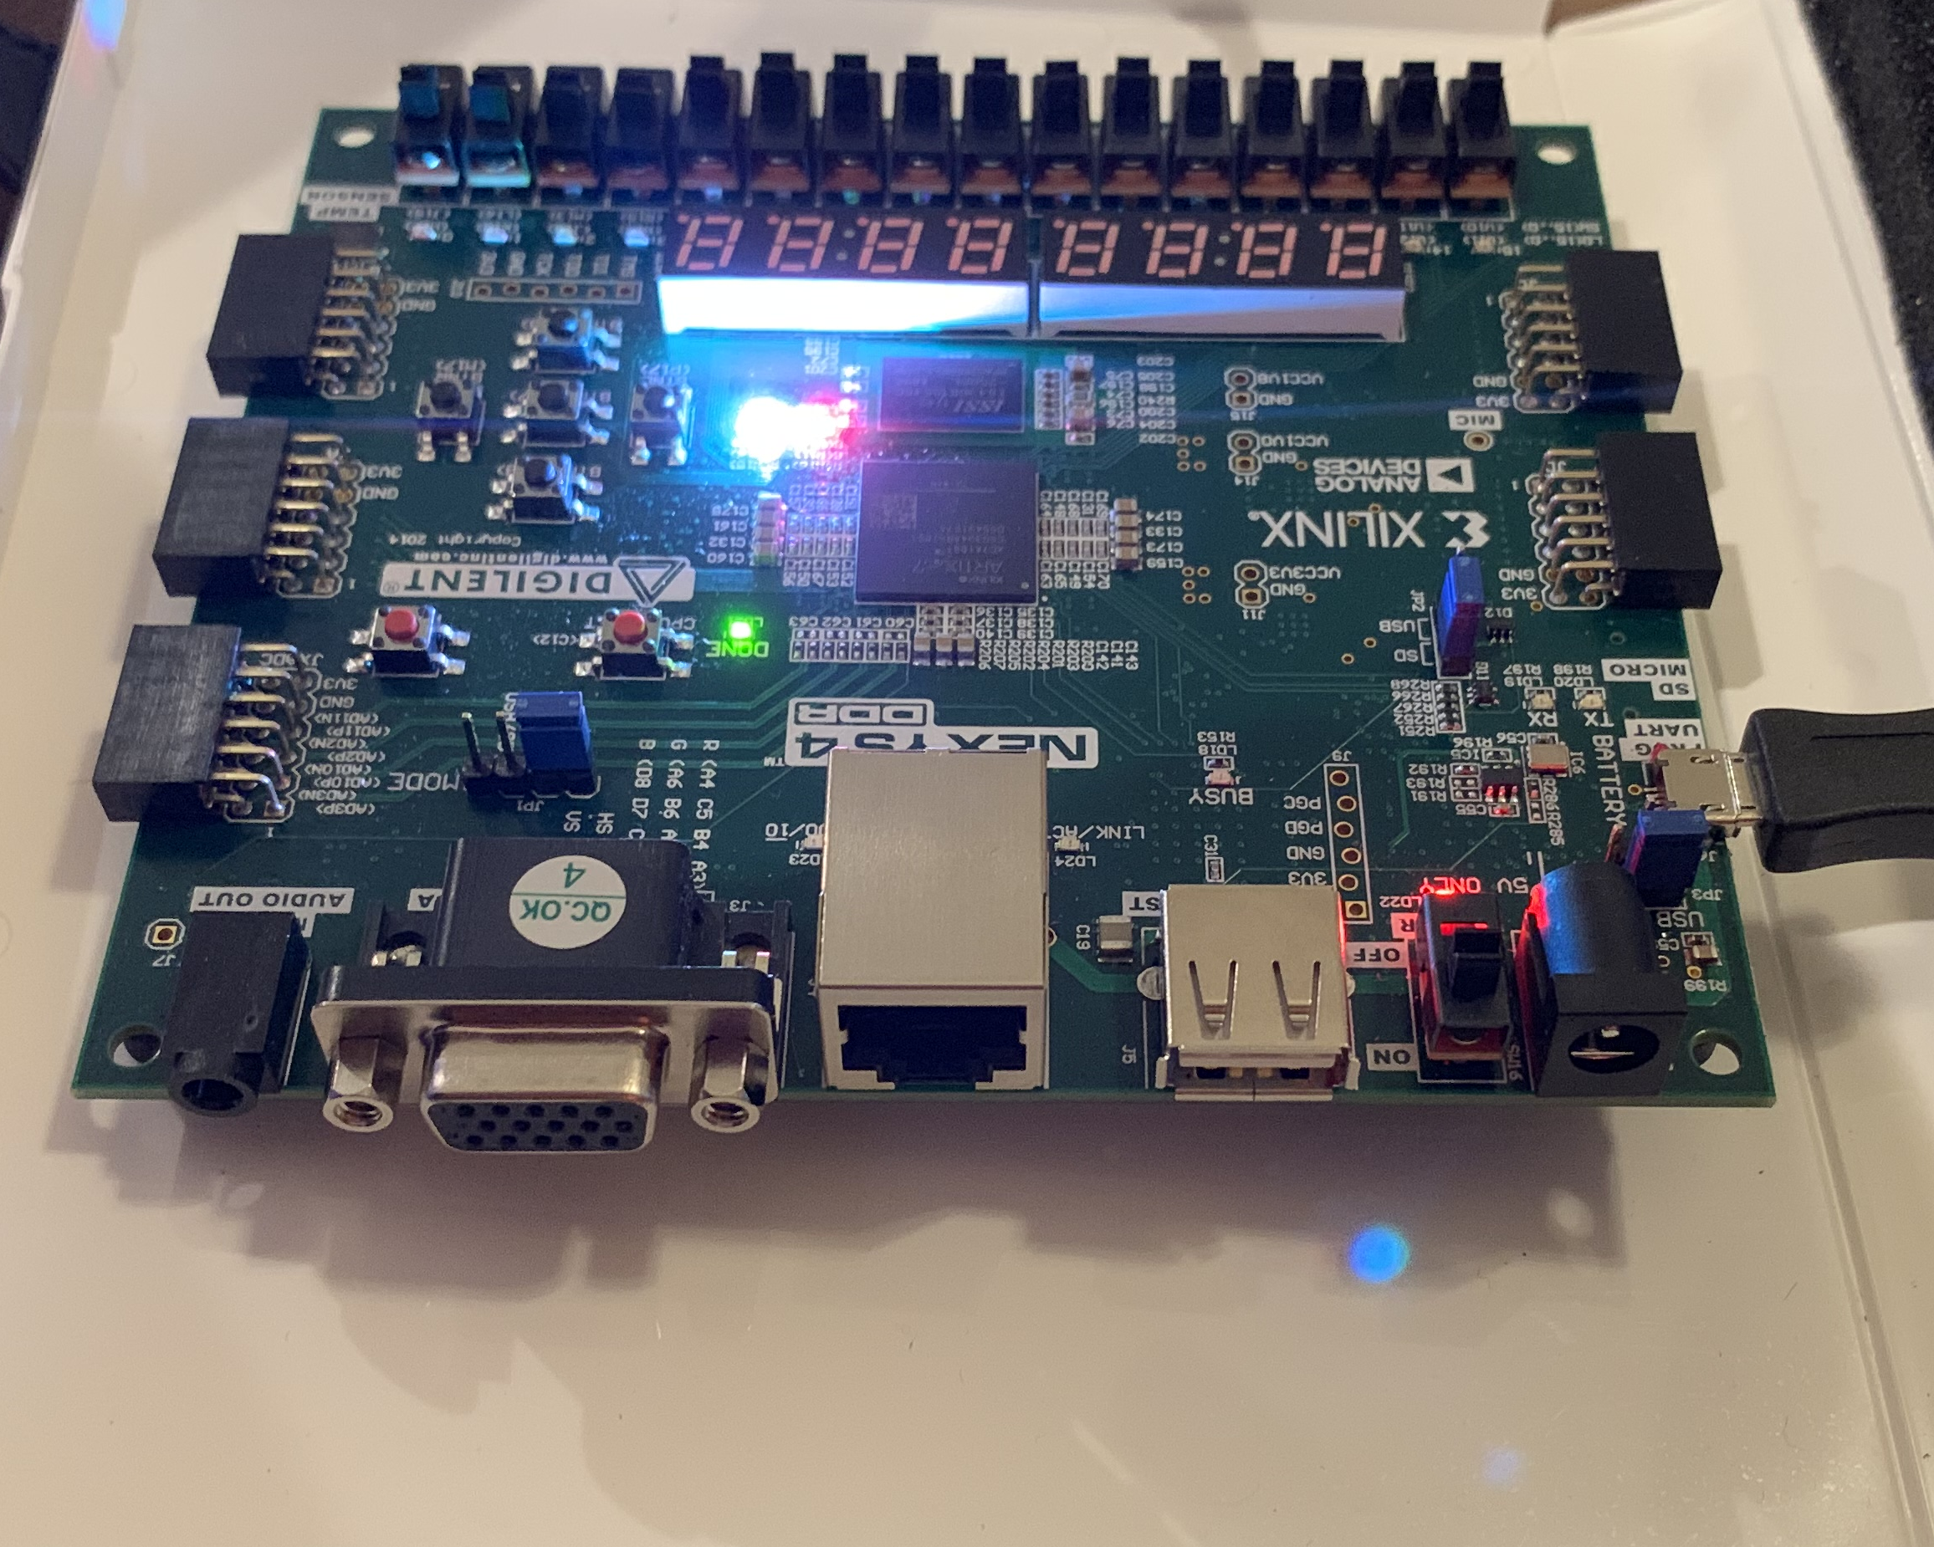
Inspiration
Experience developing boards with LED indicators
Communications (strobe)
Power Indicators (Charge status, on/off indicators, etc.)
LEDs can be used to communicate Error codes for Field Troubleshooting
Communications Errors (i.e. baud rate mismatch, etc.)
Power Quality Issues (low voltage, burnt fuse, etc.)

Slide 5
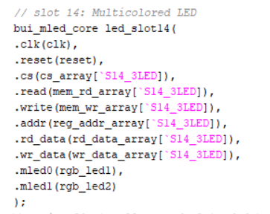
HDL Development
Individual LED Object
4 Inputs, 1 3bit Output per LED element
Clock, Red, Green, and Blue input signals
Mled [2:0] output vector
Core and Wrapper
Single Register Implementation
1 Byte for MLED0, 1 Byte for MLED1
One bit per color (bits 2 – 0)
No Data Returned

Slide 6
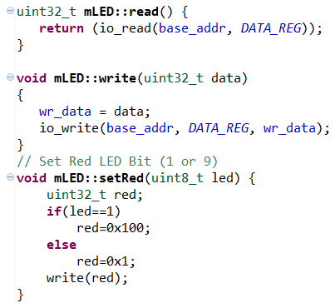
C++ Development
mLED Class
Set and Clear Functions for All colors
UINT8_T passed to indicate which LED to “program”
Read and Write functions (Register level)
Test File
Toggle Red and Green on LED0, Blue on LED1, with variable hold times
UART Communications for Status Tracking (via Terminal)

Slide 7
Potential Implementations
PWM Based Intensity Control (dimmer)
Allows for more complexity in colors
Error Coding
Frequency Controlled strobing
Color Changes/Variation
Communications
UART/SPI Monitoring
Power Supply Monitoring
Battery Charge, Low Voltage Monitoring, etc.

